Slide 1
An Introduction to R
Material heavily based on (and sometimes directly copied from) a paper by Torfs & Brauer
(http://cran.r-project.org/doc/contrib/Torfs+Brauer-Short-R-Intro.pdf)

Slide 2
About R
R is a powerful language and environment for statistical computing and graphics. It is a public domain project which is similar to the commercial S language and environment which was developed at Bell Laboratories (formerly AT&T, now Lucent Technologies) by John Chambers and colleagues.
R can be considered as a different implementation of S, and is much used in as an educational language and research tool.
Currently it is also used in different industries as well
The main advantages of R are the fact that R is freeware and that there is a lot of help available online.
Because R is freeware, it is constantly being updated, and the syntax for many commands often changes
It is quite similar to other programming packages such as MatLab (not freeware), but more user-friendly than programming languages such as C++ or Fortran.
You can use R as it is, but for educational purposes we prefer to use R in combination with the RStudio interface (also freeware), which has an organized layout and several extra options.

Slide 3
Installing R and RStudio
To install R on your computer go to the website of R: http://www.r-project.org/
The website has the most recent version of R (4.2.1)
Click download CRAN in the left bar (CRAN stands for Comprehensive R Archive Network)
Choose a download site (it should be quicker to download from a USA/PA site)
Choose the appropriate operating system (Windows or Mac)
Click base
On the next page, click on the download link and choose default answers for all questions
In addition, Windows users should also download RTools from https://cran.r-project.org/bin/windows/Rtools/. The version you would want to download is Rtools 4.2)
Doesn’t seem to be necessary for Mac Users (??)
After finishing this setup, you should see an ”R” icon on you desktop. Clicking on this would start up the standard interface.
It’s recommended to use the RStudio interface (Open Source License).
To install the free version of Rstudio Desktop, go to: http://www.rstudio.org/ and follow the instructions (choose recommended/default settings for all questions)

Slide 4
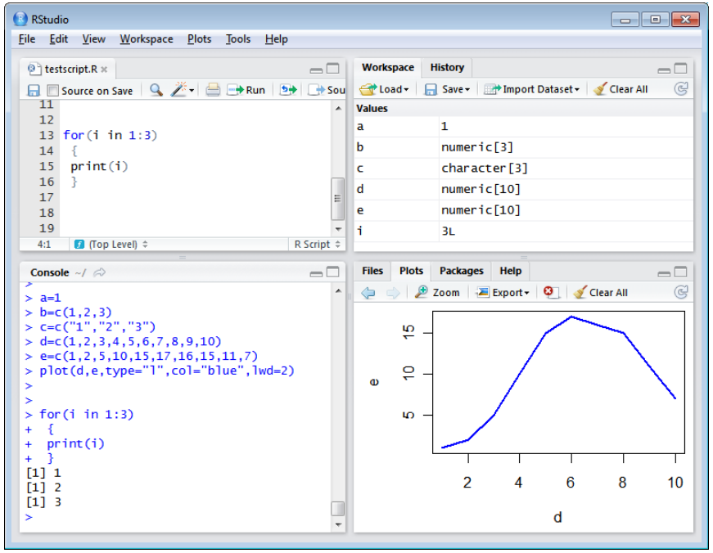
RStudio Layout
Bottom left: console (command) window. Here you can type simple commands
Top left: editor window (also called script window). Collections of commands (scripts) can be edited and saved. When you don’t get this window, you can open it with File → New → R script. Just typing a command in the editor window is not enough, it has to get into the command window before R executes the command. If you want to run one or more lines from the script window (or the whole script), you can select the lines and click Run or press CTRL+ENTER.
Top right: workspace / history window. In the workspace window you can see which data and values R has in its memory. You can view and edit the values by clicking on them.
Bottom right: files / plots / packages / help window. Here you can open files, view plots (also previous plots), install and load packages or use the help function.

Slide 5
Setting the Working Directory
Your working directory is the folder on your computer in which you are currently working.
When you ask R to open a certain file, it will look in the working directory for this file, and when you tell R to save a data file or figure, it will save it in the working directory.
Before you start working, please set your working directory to where all your data and script files are or should be stored. Type in the command window: setwd("directoryname"). For example:
Windows > setwd("C:/MUSA 501/Lecture 2/")
Mac > setwd("/Users/MacBookPro/Lecture 2")
Discuss “ vs. " (and also ‘ vs. ')
Make sure that the slashes are forward slashes and that you don’t forget the quotes
R is case sensitive, so make sure you write capitals where necessary.
Within RStudio you can also go to Tools / Global Options / Set working directory

Slide 6
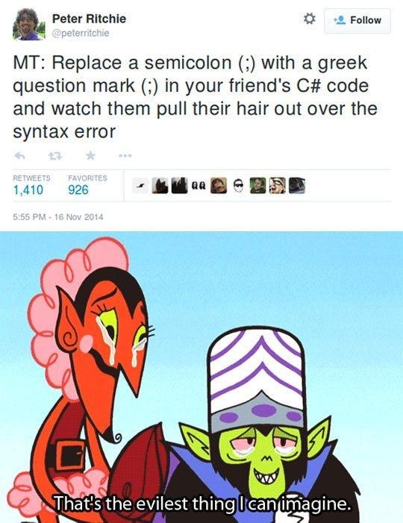

Slide 7
Packages and Libraries
R can do many statistical, GIS, data mining and other analyses. They are organized in so-called packages or libraries.
With the standard installation, most common packages are installed.
To get a list of all installed packages, go to the packages window or type library() in the console window.
If the box in front of the package name is ticked, the package is loaded (activated) and can be used.
There are many more packages available on the R website. Many of them are written by R users. They include packages for advanced statistical analysis, GIS, spatial statistics, data mining, etc.
This is the reason the most cutting-edge tools first come to R and only then make it into commercial software.
Installing new packages is very simple. For instance, if you want to run the package nnet, used for multinomial logistic regression, you would simply type:
> install.packages("nnet")
> library(nnet)
For this course, I will tell you which specific packages you need to install for which analyses.
You will be given the code for each type of analysis, and at the top of the program, you will find the packages that you’ll need to install.

Slide 8
Using R as a Calculator
R can be used as a calculator.
You can just type your equation in the command window after the “>”:
> 10^2 + 36
R will give the answer
[1] 136
If you use parentheses and forget to add the closing parenthesis, the “>” on the command line changes into a “+”. The “+” can also mean that R is still busy with some heavy computation.
If you want R to quit what it was doing and give back the “>”, press ESC

Slide 9
Workspace
You can give numbers a name. By doing so, they become so-called variables which can be used later. For example, you can type in the command window:
> a = 4 #This can also be written as a <- 4
You can see that a appears in the workspace window, which means that R now remembers what a is.
You can also ask R what a is (just type a ENTER in the command window):
> a
[1] 4
You can do calculations with a:
> a * 5
[1] 20
You can also assign a new value to a using the old one.
> a = a + 10
> a
[1] 14
To remove all variables from R’s memory, type rm(list=ls()) or click “clear all” in the workspace window.
You can see that RStudio then empties the workspace window.
If you only want to remove the variable a, you can type rm(a).

Slide 10
Review: Matrices
Recall that an r×c matrix is a rectangular array of symbols or numbers arranged in r rows and c columns.
A matrix is almost always denoted by a single capital letter in boldface type.

Slide 11
Review: Vectors and Scalars
A column vector is an r×1 matrix, that is, a matrix with only one column.
A row vector is an 1×c matrix, that is, a matrix with only one row.
A 1×1 “matrix” is called a scalar, but it’s just an ordinary number, such as 4 or σ².

Slide 12
Scalars, Vectors and Matrices
Like in many other programs, R organizes numbers as:
scalars (a single number, 0-dimensional)
vectors (a row of numbers, 1-dimensional), and
matrices (like a table, 2-dimensional).
The a we defined on the previous slide was a scalar.
To define a vector with the numbers 3, 4 and 5, we need the function c, which is short for concatenate (paste together).
> b=c(3,4,5)
> b
[1] 3 4 5
Matrices and other 2-dimensional structures will be introduced later

Slide 13
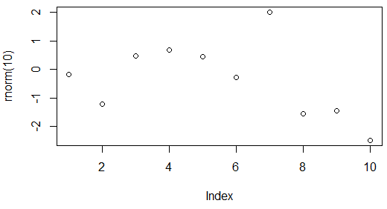
Functions
If you have a vector b=c(3,4,5) you may perform various operations with the elements of the vector b.
> mean(b) #mean of the elements of b (3,4,5)
[1] 4
> sum(b) #sum of the elements of b (3,4,5)
[1] 12
There are tons of different functions in R
Another example: let’s generate and plot 10 random numbers from the standard normal distribution
> x <-round(rnorm(10, mean=0, sd=1), 3) #round to 3 decimal digits
[1] 0.935 0.086 1.369 0.478 -0.548 0.409 0.529 0.077 -0.466 0.574
> plot(x)

Slide 14
Getting Help for R Commands
How do we know which arguments to include in each command?
There is a large amount of (free) documentation and help available.
Some help is automatically installed.
E.g., typing in the console window the command help(rnorm) gives help on the rnorm function. It gives a description of the function, possible arguments and the values that are used as default for optional arguments.
E.g., Typing example(rnorm) gives some examples of how the function can be used.
To get to manuals, we can type help.start() in the console window
The following links can also be very useful:
http://cran.r-project.org/doc/manuals/R-intro.pdf (full manual)
http://cran.r-project.org/doc/contrib/Short-refcard.pdf (short reference card)
http://zoonek2.free.fr/UNIX/48_R/all.html (many examples)
http://rwiki.sciviews.org/doku.php (user wiki)
http://www.statmethods.net/ (helpful for users of other programming languages)
http://mathesaurus.sourceforge.net/ (dictionary for programming languages)
http://www.ats.ucla.edu/stat/r/ (excellent for stats help)
Online forums of R users
Just using Google

Slide 15


Slide 16
Data Structures: Vectors
> vec1 = c(1,4,6,8,10) #we’ve seen the c() command before
> vec1
[1] 1 4 6 8 10
> vec1[5] #getting the 5th element of vec1
[1] 10
> vec1[3] = 12 #replacing the 3rd element (6) with 12
> vec1
[1] 1 4 12 8 10
> vec2 = seq(from=0, to=1, by=0.25) #elements are multiples of 0.25 from 0 to 1
> vec2
[1] 0.00 0.25 0.50 0.75 1.00
> sum(vec1) #sum of vec1 elements
[1] 35 #1+4+12+8+10 = 35
> vec1 + vec2 #vec1 & vec2 both have 5 elements, can be added
[1] 1.00 4.25 12.50 8.75 11.00 #corresponding elements of each vector are added

Slide 17
Data Structures: Matrices
Matrices are like 2-dimensional vectors (or like data tables)
> mat=matrix(data=c(9,2,3,4,5,6),ncol=3)
> mat
[,1] [,2] [,3]
[1,] 9 3 5
[2,] 2 4 6
The argument data specifies which numbers should be in the matrix. We use either ncol to specify the number of columns or nrow to specify the number of rows.
Matrix-operations are similar to vector operations:
> mat[1,2] #element in 1st row, 2nd column
[1] 3
> r2 <- mat[2,] #r2 is a vector which is the 2nd row of matrix
[1] 2 4 6
> c2 <- mat[,2] #c2 is a vector which is the 2nd column of matrix
[1] 3 4
> mean(mat) #mean of all 6 matrix elements (9, 3, 5, 2, 4, 6)
[1] 4.8333

Slide 18
Data Structures: Matrices (Cont’d)
>mat1=matrix(data=c(9,2,3,4,5,6),ncol=3)
>mat2=matrix(data=c(7,6,5,3,2,8),nrow=2)
>mat1
[,1] [,2] [,3]
[1,] 9 3 5
[2,] 2 4 6
>mat2
[,1] [,2] [,3]
[1,] 7 5 2
[2,] 6 3 8
>matsum=mat1+mat2
>matsum
[,1] [,2] [,3]
[1,] 16 8 7
[2,] 8 7 14
#in order to append 2+ matrices, number of columns has to be the same; in order to merge, number of rows has to be the same
>merging=cbind(mat1,mat2)
>merging
[,1] [,2] [,3] [,4] [,5] [,6]
[1,] 9 3 5 7 5 2
[2,] 2 4 6 6 3 8
>appending=rbind(mat1,mat2)
>appending
[,1] [,2] [,3]
[1,] 9 3 5
[2,] 2 4 6
[3,] 7 5 2
[4,] 6 3 8
>trans=t(appending) #transposing the matrix
[,1] [,2] [,3] [,4]
[1,] 9 2 7 6
[2,] 3 4 5 3
[3,] 5 6 2 8
>dim(trans) #dimensions of the matrix trans (rows x columns)
[1] 3 4

Slide 19
Data Structures: Arrays
These are similar to the matrices although they can have 2 or more dimensions.
We won’t be using them much in this class.
#we put numbers 1-24 into four 2x3 matrices
>z <- array(1:24, dim=c(2,3,4))
> z
, , 1
[,1] [,2] [,3]
[1,] 1 3 5
[2,] 2 4 6
, , 2
[,1] [,2] [,3]
[1,] 7 9 11
[2,] 8 10 12
, , 3
[,1] [,2] [,3]
[1,] 13 15 17
[2,] 14 16 18
, , 4
[,1] [,2] [,3]
[1,] 19 21 23
[2,] 20 22 24
Source: http://venus.ifca.unican.es/Rintro/dataStruct.html

Slide 20
Data Structures: Data Frames
A data frame is a matrix with names above the columns. This is nice, because you can call and use one of the columns without knowing in which position it is.
>t = data.frame(x = c(11,12,14), y = c(19,20,21), z = c(10,9,7))
>t
x y z
1 11 19 10
2 12 20 9
3 14 21 7
>mean(t$z) #takes mean of column z in dataframe t
[1] 8.666667
>mean(t[["z"]]) #same as mean(t$z)
[1] 8.666667

Slide 21
Data Structures: Lists
The main advantage of lists is that the “columns” (which aren’t really ordered in columns any more, but are more a collection of vectors) don’t have to be of the same length, unlike matrices and data frames.
We won’t be using them much in this course.
>L = list(one=1, two=c(1,2), five=seq(0, 1, length=5))
>L
$one
[1] 1
$two
[1] 1 2
$five
[1] 0.00 0.25 0.50 0.75 1.00
>names(L) #what’s in the list?
[1] "one" "two" "five"
>L$five + 10
[1] 10.00 10.25 10.50 10.75 11.00

Slide 22
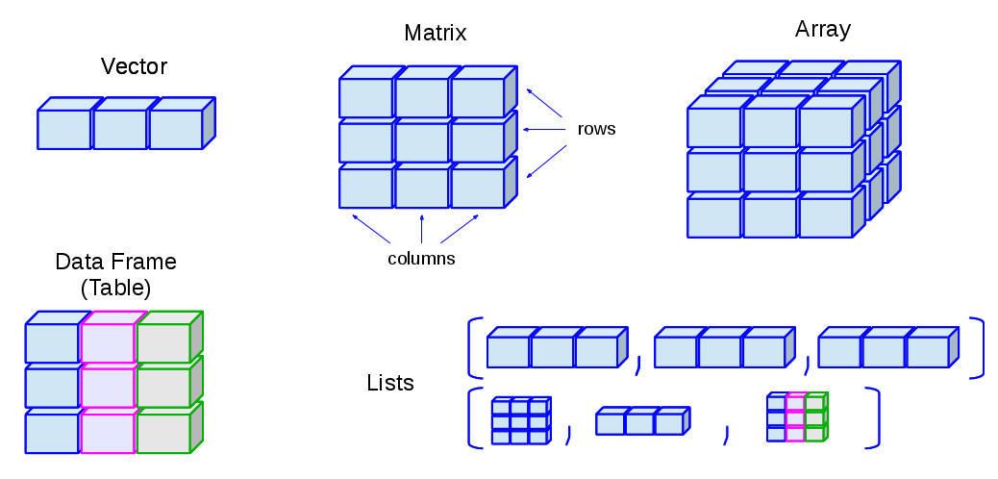
Data Structures: Summary
Source: http://venus.ifca.unican.es/Rintro/_images/dataStructuresNew.png

Slide 23
Reading and Writing Data Files
>d = data.frame(a = c(3,4,5), b = c(12,43,54)) #create a data frame d
>d
a b
1 3 12
2 4 43
3 5 54
>write.table(d, file="tst0.txt", row.names=FALSE) #export data frame d as .txt file in working directory
>d2 = read.table(file="tst0.txt", header=TRUE) #import it back into an R data frame (and call it d2)
>d2
a b
1 3 12
2 4 43
3 5 54
> mydata <- read.csv(“RegressionData.csv") #importing RegressionData.csv & calling it mydata

Slide 24
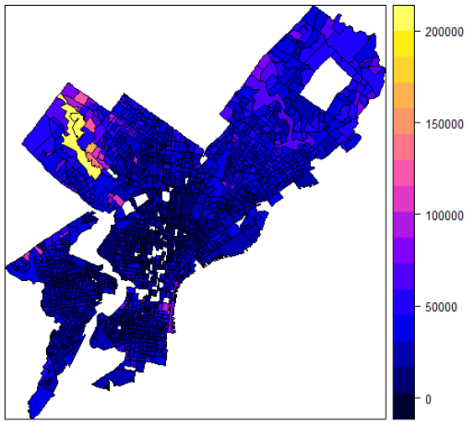
Reading and Writing Shapefiles
>install.packages(“sp")
>install.packages("maptools")
>install.packages(“sf")
>install.packages(“rgdal”)
>library(sp)
>library(maptools)
>library(sf)
>library(rgdal)
#Reading Polygon Boundary.shp from our working directory
>PhillyData <- readOGR(“RegressionData.shp”)
#Plotting the shapefile (making the border red)
>plot(PhillyData, border=“red”)
#Setting the titles for the plot above
>title(main = “Philadelphia 2000 Data“, sub=“Census BGs”)
#Making a nice, choropleth map of the variable MEDHHINC
>spplot(PhillyData, “MEDHHINC”)
#Exporting back to Shapefile format
#Writing back to shapefile format:Exported_PhillyData.shp will appear in your #working directory
>writeOGR(PhillyData, “.”, “Exported_PhillyData”, driver=“ESRI Shapefile”)
#For more info on mapping in R, please see this link

Slide 25
Not Available (Missing) Data
Imagine we want to import the following dataset (called Missing Data.csv)
We have some missing data here for variables a and c!
Let’s import the data and see how R handles the missing data:
>NAEx = read.csv("Missing Data.csv")
>NAEx
a b c
1 1 3 4
2 NA 5 2
3 3 6 NA
Let’s try to compute the max of NAExample
>max(NAEx) #no results due to NA values
[1] NA
>max(NAEx, na.rm=TRUE) #ignore NA values
[1] 6
na.rm command tells R whether NA values should be stripped before the computation proceeds. This or similar command exists in many R functions.
Let’s create a new variable d, which is c+1
>NAEx$d = NAEx$c + 1
>NAEx #we see that NAEx has new column d
a b c d
1 1 3 4 5
2 NA 5 2 3
3 3 6 NA NA #NA+1 = NA
a | b | c
1 | 3 | 4
 | 5 | 2
3 | 6

Slide 26
Classes: Character (String)
Sometimes we want to specify something which is not a number, for example the name of a measurement station or data file. In that case we want the variable to be a character string instead of a number.
An object in R can have one of several so-called classes. The most important three are numeric, character and POSIX (date-time combinations). You can ask R what class a certain variable is by typing class(...).
To tell R that something is a character string, you should type the text between single or double quotes; otherwise R will start looking for a defined variable with the same name.
>m = "apples"
>m
[1] "apples"
>n = pears
Error: object ‘pears’ not found #no quotes
>m + 2 #you cannot do computations with character strings
Error in m + 2 : non-numeric argument to binary operator
We will see more character operations when we get to text mining. In the meantime here are some helpful pages:
http://www.r-tutor.com/r-introduction/basic-data-types/character
http://gastonsanchez.com/Handling_and_Processing_Strings_in_R.pdf

Slide 27
Classes: Date and Time
We won’t be using date/time operations much in this course
Here are some helpful pages on date/time operations:
http://www.statmethods.net/input/dates.html
http://www.noamross.net/blog/2014/2/10/using-times-and-dates-in-r---presentation-code.html
http://www.stat.berkeley.edu/~s133/dates.html
http://www.dummies.com/how-to/content/how-to-work-with-dates-in-r.html

Slide 28
If-Else Statements
The if-statement is used when certain computations should only be done when a certain condition is met (and maybe something else should be done when the condition is not met). An example:
Let’s say that w=3. Then, we will tell R to create d, such that d=2 if w<5 and d=10 otherwise. Here, because w=3<5, d=2.
>w = 3
>if(w < 5 ) {d=2} else {d=10}
>d
2 #since w<5, d=2; otherwise it’d be 10

Slide 29
Writing Your Own Functions
Functions you program yourself work in the same way as pre-programmed R functions.
The function below has 2 arguments (inputs), arg1 and arg2.
You input two values, arg1 and arg2. Then, you calculate w=arg1^2, and output the sum of w and arg2.
>fun1 = function(arg1, arg2 )
{
w = arg1 ^ 2 #generate variable w
return(arg2 + w) #fun1 output is arg2 + w
}
>fun1(arg1 = 3, arg2 = 5)
>[1] 14 #w=3^2; return = arg2+w = 5+9 = 14

Slide 30
Some Useful Statistical Functions
>a = c(1,1,1,1,0,0,0,0,0,0,2,2,2,2,3,3,3,4)
>mean(a) #mean of elements in a
[1] 1.388889
>max(a) #maximum element in a
[1] 4
>round(sd(a),2) #standard deviation of a, rounded to 2 decimal places
[1] 1.29
>sum(a) #sum the elements of a
[1] 25
>summary(a) #summary statistics, median and quartiles
Min 1st Qu. Median Mean 3rd Qu. Max
0.00 0.00 1.00 1.389 2.00 4.00
>summary(factor(a)) #create a frequency table of a
0 1 2 3 4 #each element of a
6 4 4 3 1 #how often each element appears
>summary(mydata$a) #same logic & functions work if a is a variable in dataset mydata

Slide 31
Avoiding Scientific Notation
Results are often given in scientific notation (e..g, 2.34x10^-5).
To avoid this, use the following command in the beginning of every program:
>options(scipen=999)

